Slide 1
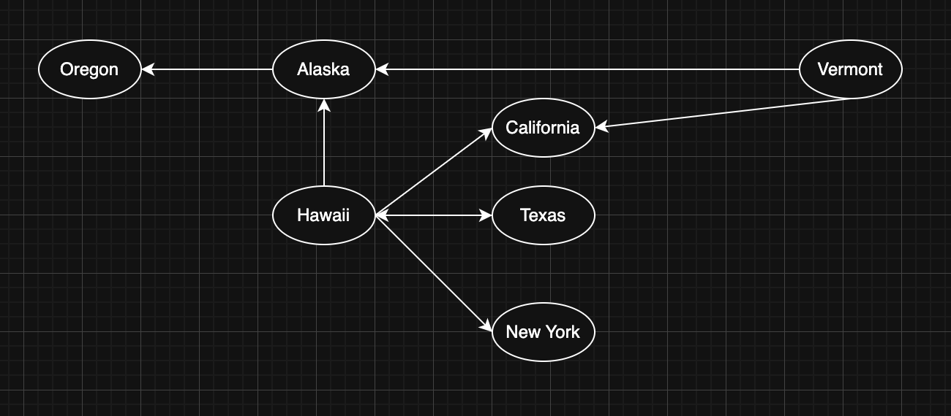
CMSC204
Kartchner
V(StateGraph) = {Oregon, Alaska, Texas, Hawaii, Vermont, NewYork, California}
E(StateGraph) = {(Alaska, Oregon), (Hawaii, Alaska), (Hawaii, Texas), (Texas, Hawaii), (Hawaii, California), (Hawaii, New York), (Texas, Vermont), (Vermont, California), (Vermont, Alaska)}
1. Draw the StateGraph
{Oregon, Alaska, Texas, Hawaii, Vermont, NewYork California}
{(Alaska, Oregon), (Hawaii, Alaska), (Hawaii, Texas), (Texas, Hawaii), (Hawaii, California), (Hawaii, New York), (Texas, Vermont), (Vermont, California), (Vermont, Alaska)}
No
Yes
Texas

Slide 2
a. Show the adjacency matrix that would describe the edges in the graph. Store the vertices in alphabetical order
States
 | 0 | 1 | 2 | 3 | 4 | 5 | 6
0 | 0 | 0 | 0 | 0 | 0 | 0 | 0
1 | 0 | 0 | 0 | 0 | 1 | 0 | 0
2 | 1 | 1 | 0 | 1 | 0 | 1 | 0
3 | 0 | 0 | 0 | 0 | 0 | 0 | 0
4 | 0 | 0 | 0 | 0 | 0 | 0 | 0
5 | 0 | 0 | 1 | 0 | 0 | 0 | 1
6 | 1 | 1 | 0 | 0 | 0 | 0 | 0
Oregon
Alaska
Hawaii
NewYork
California
Texas
Vermont
3. b. Show the adjacency lists
that would describe the edges in the graph
Oregon
Alaska
Texas
Hawaii
Vermont
NewYork
California
OR
HI
VT
AK
CA
NY
TX
AK
CA

Slide 3
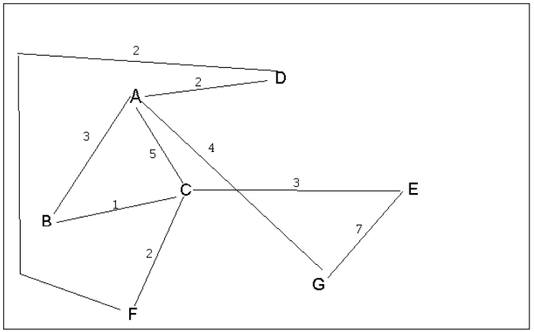
4 a. Which of the following lists the graph nodes in depth first order beginning with E?
A) E, G, F, C, D, B, A
B) G, A, E, C, B, F, D
C) E, G, A, D, F, C, B
D) E, C, F, B, A, D, G
4 b. Which of the following lists the graph nodes in breadth first order beginning at F?
A) F, C, D, A, B, E, G
B) F, D, C, A, B, C, G
C) F, C, D, B, G, A, E
D) a, b, and c are all breadth first traversals

Slide 4
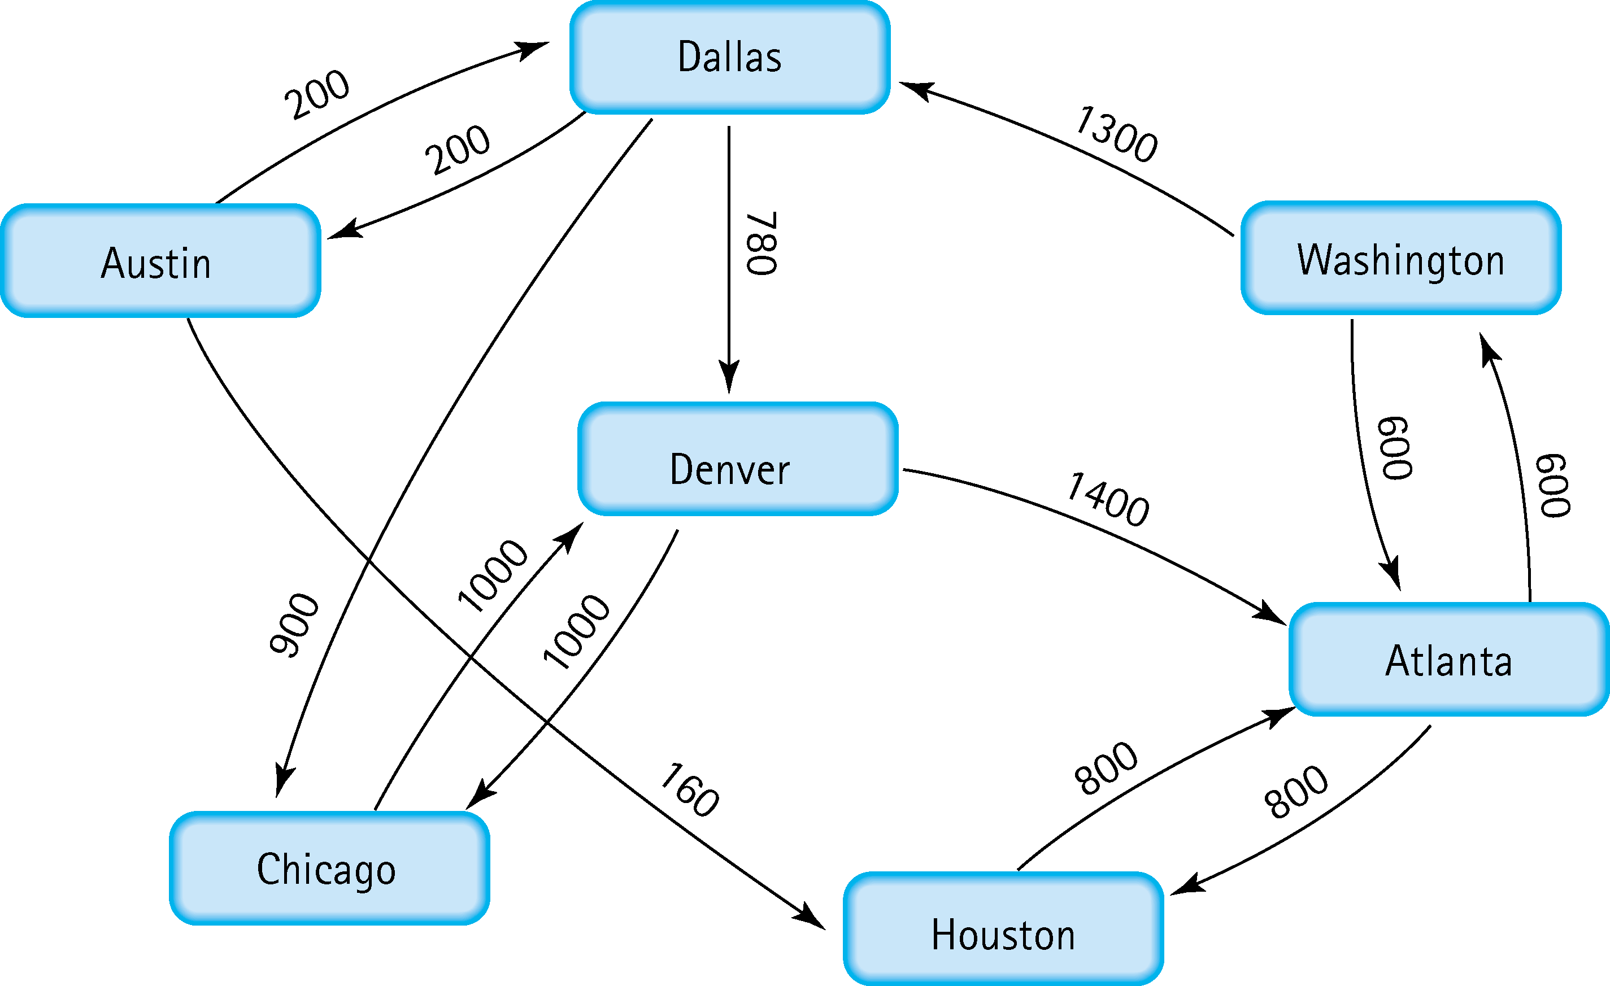
5. Find the shortest distance from Atlanta to every other city
To Washington: 600
To Houston: 800
To Denver: Atlanta to Washington to Dallas to Denver 2680
To Dallas: Atlanta to Washington to Dallas 1900
To Chicago: Atlanta to Washington to Dallas to Chicago 2800 To Austin: Atlanta to Washington to Dallas to Austin 2100

Slide 5
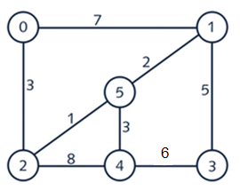
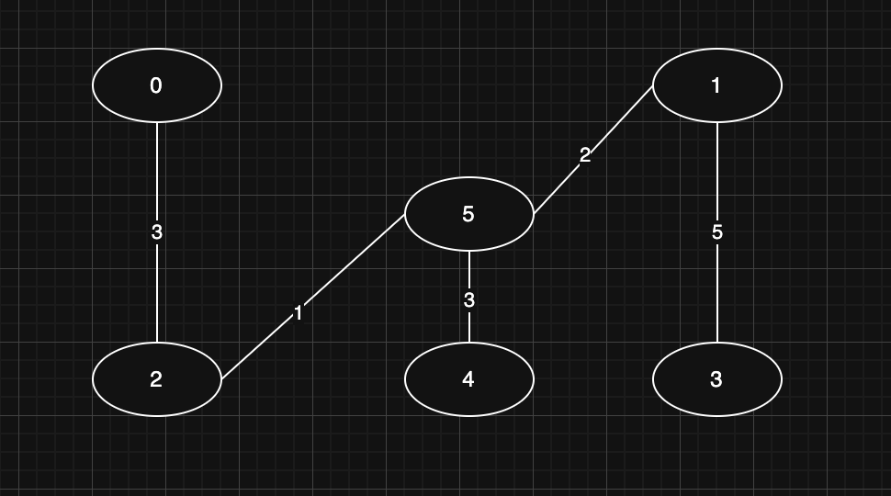
6. Find the minimal spanning tree using Prim’s algorithm. Use
0 as the source vertex . Show the steps.
-Add Node 0
-Consider edges 3 and 7
-Choose edge 3 -Add Node 2
-Consider edges 1 and 8
-Choose edge 1
-Add Node 5
-Consider edges 2 and 3 -Choose edge 2
-Add Node 1
-Consider edges 7 and 5
-Choose edge 5
-Add Node 3
-Consider edges 6 and 3 -Choose edge 3 -Add Node 4

Slide 6
7. Find the minimal spanning tree using Kruskal’s algorithm.
Show the weights in order and the steps.
2 | 5 | 1
1 | 5 | 2
0 | 2 | 3
4 | 5 | 3
1 | 3 | 5
3 | 4 | 6
0 | 1 | 7
2 | 4 | 8

Slide 7
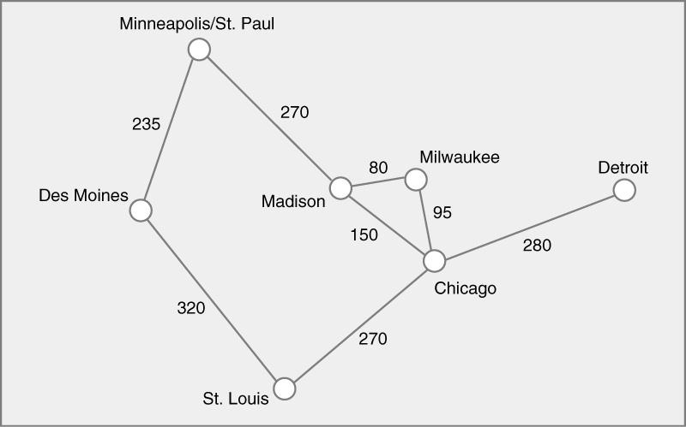
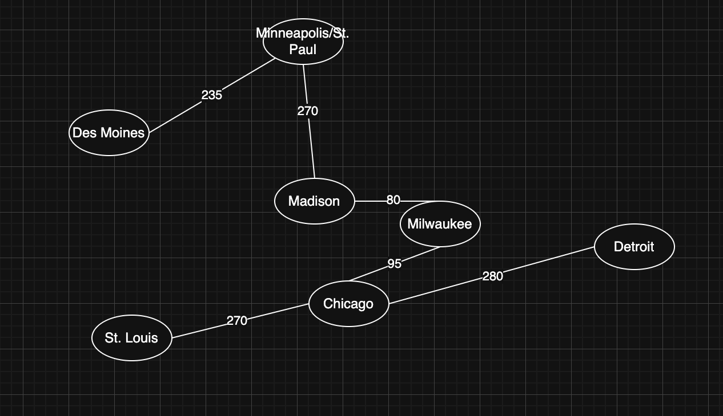
8. Find the minimal spanning tree using the algorithm you prefer. Use
Minneapolis/St. Paul as the source vertex

Slide 8
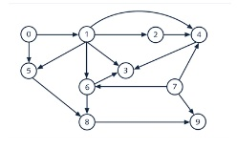
9. List the nodes of the graph in a breadth first topological ordering. Show the
steps using arrays predCount, topologicalOrder and a queue
PredCount:
0 | 0 | 0 | 0 | 0 | 0 | 0 | 0 | 0 | 0
0 | 7 | 1 | 2 | 5 | 6 | 4 | 8 | 3 | 9
0 | 7 | 1 | 2 | 5 | 6 | 4 | 8 | 3 | 9
TopologicalOrder:

Slide 9
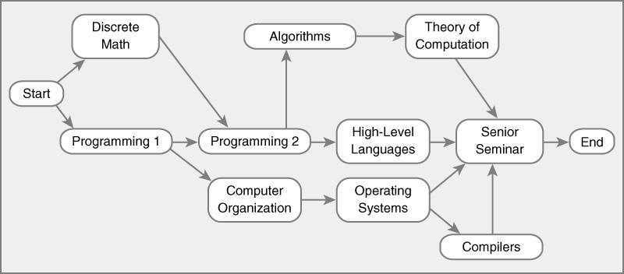
10. List the nodes of the graph in a breadth first topological ordering.
-Start
-Discrete Math
-Programming1
-Programing 2
-Computer Organization
-Algorithms
-High-Level Languages
-Operating Systems
-Theory of Computation
-Compilers
-Senior Seminar
-End

